Slide 1
Data Management Technologies
IS465: Data Management and Governance

Slide 2
Outline
Introduction
Data Warehousing and Data Mart
Data Lakes and Data Reservoirs
Cloud Computing and Data Management
Big Data and NoSQL Databases

Slide 3
Introduction

Slide 4
Data Management Technologies: An Overview
Data management technologies refer to the tools and systems used to collect, store, organize, and manage data across various industries and applications.
Effective data management is crucial for making informed decisions, optimizing processes, and ensuring data security and privacy.

Slide 5
Types of Data Management Technologies
Data storage technologies
Systems used to store and retrieve data, such as relational databases, NoSQL databases, and data warehouses. Examples include MySQL, MongoDB, and Amazon Redshift.
Data processing technologies
Tools used to process, transform, and analyze data, such as data integration, data cleansing, and data mining. Examples include Apache NiFi, Talend, and RapidMiner.

Slide 6
Types of Data Management Technologies
Data governance technologies
Systems used to manage data quality, security, and privacy, such as data catalogs, data dictionaries, and data access control. Examples include Apache Atlas, AWS Lake Formation, and DataClarity.
Data visualization technologies
Tools used to create interactive and intuitive visualizations of data, such as business intelligence, data analytics, and data dashboards. Examples include Tableau, Power BI, and QlikView.

Slide 7
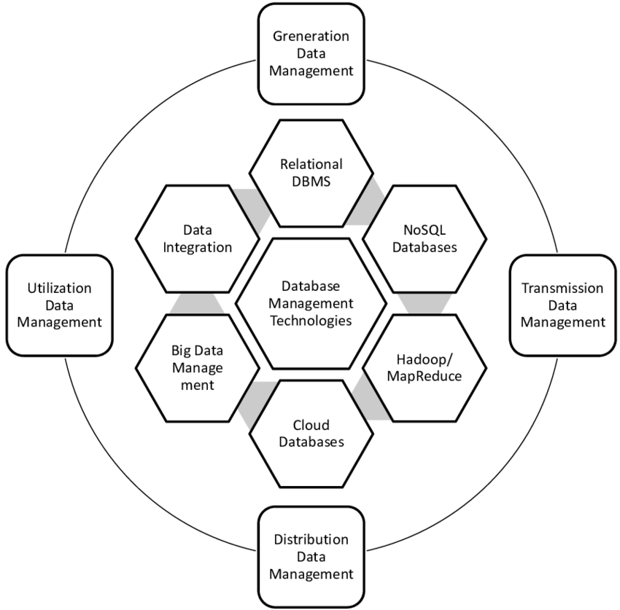
Modern database management technologies

Slide 8
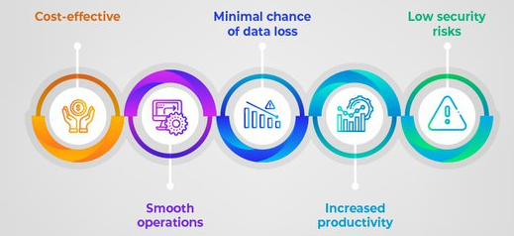
Importance of Data Management Technologies
Data management technologies are critical for organizations to collect, store, process, and analyze large volumes of data.
Data-driven decision making has become a norm in today's business landscape.
Data management technologies help organizations to make informed decisions, improve operational efficiency, and stay competitive.

Slide 9
Improving Business Outcomes
Data management technologies help organizations to:
Improve data quality and accuracy
Enhance data security and privacy
Increase operational efficiency and productivity
Improve customer experience and satisfaction
Make informed decisions based on data insights
Stay competitive in the marketplace

Slide 10
Improving Business Outcomes
Data management technologies also enable organizations to:
Identify new business opportunities
Optimize business processes
Improve financial performance
Enhance strategic decision making

Slide 11
Types of Data Management Technologies
Data storage technologies:
Relational databases (e.g., MySQL, Oracle)
NoSQL databases (e.g., MongoDB, Cassandra)
Data warehouses (e.g., Amazon Redshift, Google BigQuery)
Data lakes (e.g., Apache Hadoop, AWS S3)
Data processing technologies:
Data integration (e.g., Talend, Informatica)
Data cleansing (e.g., Trifacta, DataClarity)
Data transformation (e.g., Apache Beam, AWS Lambda)
Data streaming (e.g., Apache Kafka, AWS Kinesis)

Slide 12
Types of Data Management Technologies
Data governance technologies:
Data catalogs (e.g., Apache Atlas, AWS Lake Formation)
Data dictionaries (e.g., Apache Hive, AWS Glue)
Data access control (e.g., Apache Ranger, AWS IAM)
Data analytics technologies:
Business intelligence (e.g., Tableau, Power BI)
Data visualization (e.g., D3.js, Matplotlib)
Predictive analytics (e.g., R, Python)
Machine learning (e.g., TensorFlow, PyTorch)

Slide 13
Key Features and Use Cases
Technology | Key Features | Use Cases
Relational databases | SQL querying, data consistency, transaction management, data security | Traditional data storage and management Online transactions and e-commerce Enterprise data management
NoSQL databases | Scalability, flexible schema, high availability, big data analytics | Big data storage and processing Real-time web analytics IoT data management
Cloud storage | Scalability, cost-effectiveness, data accessibility, collaboration | File sharing and collaboration Backup and archiving Cloud-based data storage
Data warehousing | Data integration, data cleansing, data transformation, data mining | Data analysis and reporting Business intelligence Data-driven decision making
Data lakes | Data storage, data processing, data analytics, data visualization | Big data storage and processing Data science and machine learning Data-driven decision making

Slide 14
Key Features and Use Cases
Technology | Key Features | Use Cases
Data governance | Data quality, data security, data compliance, data accessibility | Data management and oversight Data risk management Data privacy and protection
Master data management | Data integration, data cleansing, data transformation, data security | Data management and oversight Data quality and consistency Data-driven decision making
Data integration | Data integration, data transformation, data mapping, data validation | Data migration and integration Data synchronization and replication Data integration for analytics
Data quality | Data validation, data cleansing, data normalization, data enrichment | Data quality and consistency Data accuracy and completeness Data-driven decision making
Data security | Data encryption, data access controls, data authentication, data backup | Data protection and privacy Data risk management Compliance and regulatory requirements
Data backup | Data backup and recovery, data archiving, data retention, data restore | Data protection and recovery Data backup and archiving Compliance and regulatory requirements
Data analytics | Data visualization, data mining, data predictive analytics, data prescriptive analytics | Data-driven decision making Business intelligence Predictive and prescriptive analytics

Slide 15
Data Warehousing and Data Mart

Slide 16
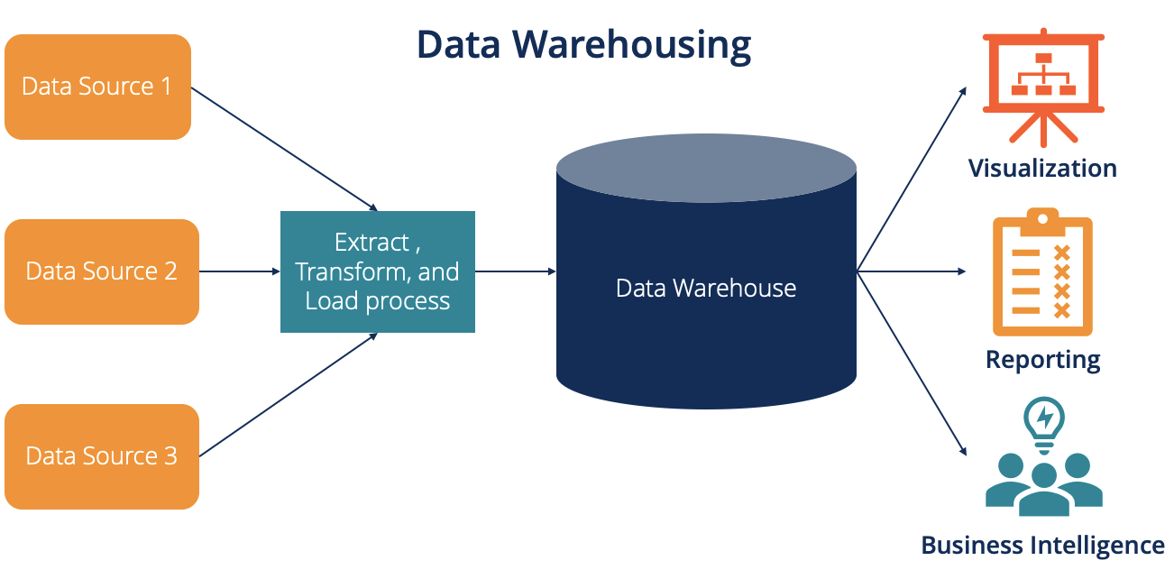
Understanding the Basics
Data warehousing is a process of collecting and storing data from various sources in a centralized repository

Slide 17
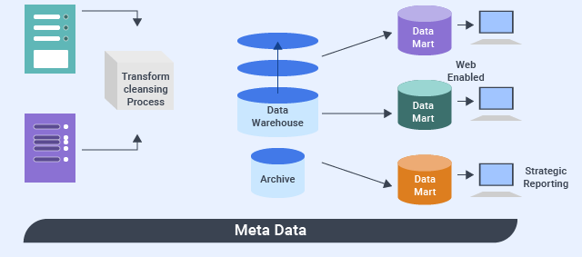
Understanding the Basics
Data mart is a subset of a data warehouse that serves a specific business function or department

Slide 18
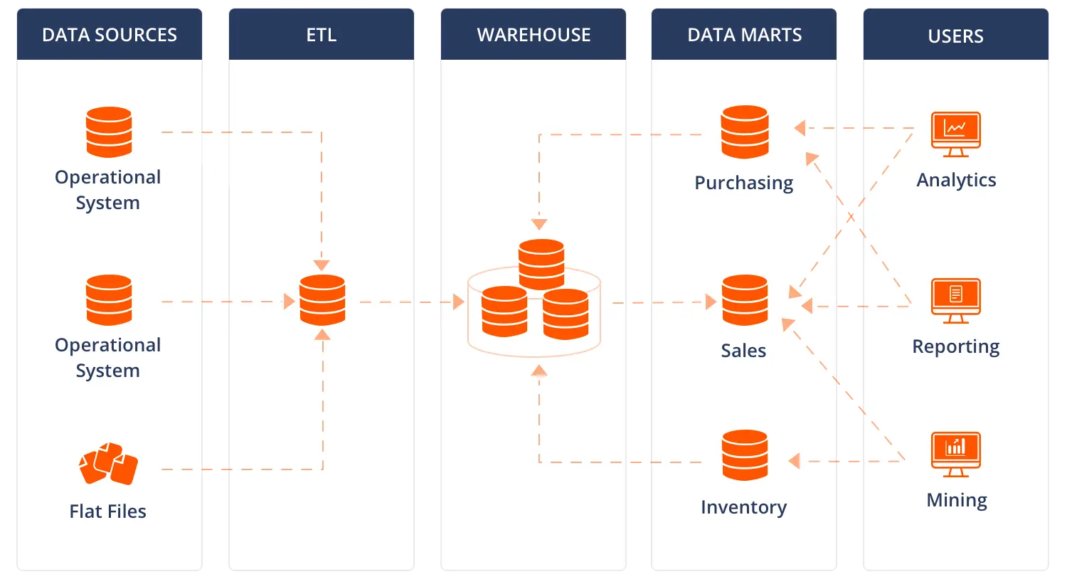
Understanding the Basics
Both data warehousing and data mart are used for data analysis and reporting

Slide 19
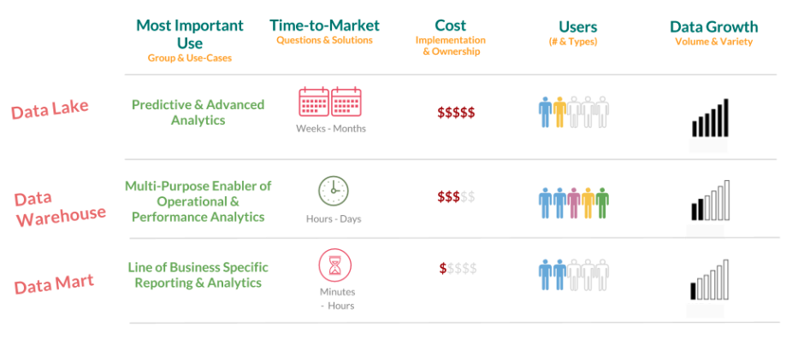
Lake, Warehouse, Mart

Slide 20
A Centralized Repository for Data
Data warehousing is a process of collecting and storing data from various sources in a centralized repository
Data warehouse is a large, centralized repository that stores data from various sources, such as transactional databases, log files, and external data sources
Data warehouse is designed to handle large volumes of data and support complex queries and analytical tasks
Data warehouse is used for data analysis, reporting, and business intelligence

Slide 21
A Subset of a Data Warehouse
Data mart is a subset of a data warehouse that serves a specific business function or department
Data mart is designed to meet the needs of a specific business area or team, such as sales, marketing, or finance
Data mart is a smaller, more focused repository that stores data relevant to a specific business function or department
Data mart is used for data analysis and reporting within a specific business area or department

Slide 22
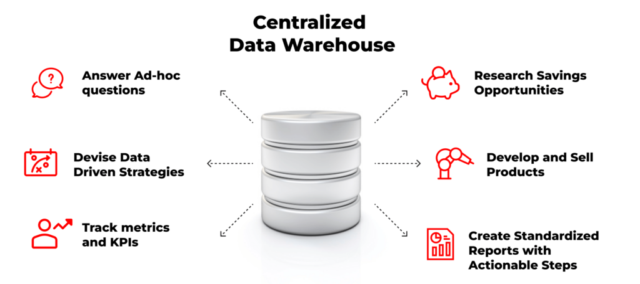
Benefits of Centralized Data Storage
Improved data quality and consistency
Enhanced data analysis and reporting capabilities
Better data-driven decision making
Improved data security and compliance
Scalability and flexibility

Slide 23
Challenges of Centralized Data Storage
Challenges
High upfront costs
Complexity in data integration and management
Limited flexibility in data schema
Data quality issues
Security and privacy concerns

Slide 24
Benefits of Focused Data Storage
Improved data analysis and reporting for specific business areas
Better data management and organization
Increased data accessibility and usability
Reduced data complexity and cost
Improved data freshness and timeliness

Slide 25
Challenges of Focused Data Storage
Limited data scope and coverage
Data duplication and inconsistency
Lack of data integration and standardization
Data security and privacy concerns
Limited scalability and flexibility

Slide 26
Industry Examples
Healthcare: patient data, medical records, and clinical trials
Finance: transactional data, financial performance, and risk management
Retail: customer data, sales data, and inventory management
Manufacturing: production data, supply chain data, and quality control

Slide 27
Departmental Examples
Sales: customer data, sales data, and sales performance
Marketing: customer data, marketing campaigns, and lead generation
Finance: financial data, budgeting, and forecasting
Human Resources: employee data, performance management, and training

Slide 28

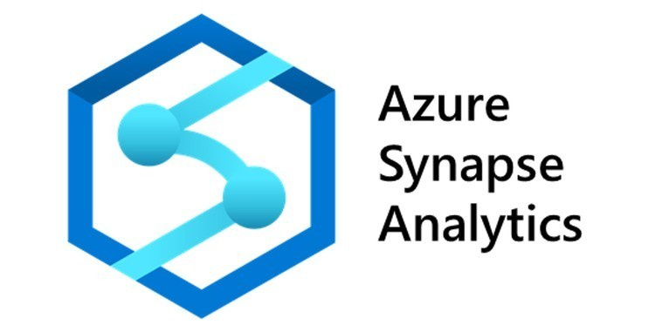
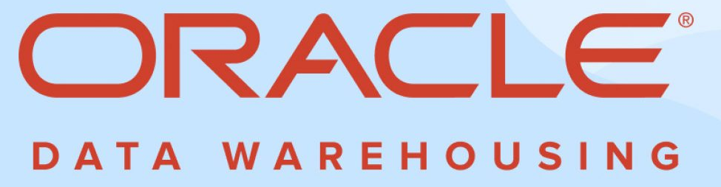
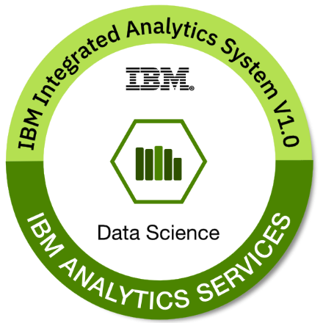

Data Warehousing Tools

Slide 29
Summary of Key Points
Data warehousing and data mart are important concepts in data management
Both have their advantages and disadvantages
Use cases for data warehousing and data mart vary by industry and department
Choosing the right tool depends on the organization's needs and other factors such as suitability, cost and familiarity.

Slide 30
Data Lakes and Data Reservoirs

Slide 31
Data Lakes and Data Reservoirs
Data lakes and data reservoirs are data storage and management solutions
They are designed to handle large amounts of data from various sources
They are used for data processing, analysis, and reporting

Slide 32
Data Lakes
A data lake is a centralized repository that stores raw, unprocessed data
Data lakes are designed to handle large amounts of data and can scale horizontally
Data lakes are schema-on-read, meaning the schema is defined when the data is queried
Data lakes are ideal for data warehousing, big data analytics, and data science

Slide 33
Data Reservoirs
A data reservoir is a repository that stores processed data
Data reservoirs are designed to handle smaller amounts of data and are optimized for query performance
Data reservoirs are schema-on-write, meaning the schema is defined when the data is ingested
Data reservoirs are ideal for operational reporting, data visualization, and real-time analytics

Slide 34
When to Use Each
Data lakes are suitable for use cases such as:
Data warehousing and big data analytics
Data science and machine learning
Data integration and data transformation
Data archiving and data retention
Data reservoirs are suitable for use cases such as:
Operational reporting and data visualization
Real-time analytics and dashboarding
Data integration and data transformation
Data quality and data governance

Slide 35
Data Lakes Pros and Cons
Pros:
Scalability
Flexibility
Data Integration
Data Agility
Cost-effective
Cons:
Complexity
Data Quality
Data Security
Data Governance
Cost

Slide 36
Advantages and Disadvantages of Data Reservoirs
Advantages:
Data reservoirs can handle large amounts of data and scale horizontally as needed
Data reservoirs can store data in various formats and schema, making it easier to handle different data sources
Data reservoirs can integrate data from multiple sources, creating a single source of truth
Data reservoirs can be more cost-effective than traditional data storage solutions, especially for large amounts of data
Disadvantages:
Data reservoirs can be complex to set up and manage, requiring specialized skills and resources
Data reservoirs can store data of varying quality, which can impact the accuracy of insights and analytics
Data reservoirs can be challenging to govern, making it difficult to ensure data accuracy, completeness, and compliance
Data reservoirs can be vulnerable to security breaches, especially if not properly secured

Slide 37
Real-World Examples of Data Lake Implementations
There are various industries that leverage data lake implementations to gain insights from their data.
Coca-Cola Andina
They built a data lake on AWS to increase their analytics team productivity by 80%
Adobe Systems
They implemented a data lake infrastructure to manage their analytics data. "Adobe Experience Cloud," is built on Amazon Web Services (AWS).

Slide 38
Use Cases
Data Lakes
Data warehousing and big data analytics
Data science and machine learning
Data integration and data transformation
Data archiving and data retention
Real-time analytics and stream processing

Slide 39
Use Cases
Data Reservoirs
Operational reporting and data visualization
Real-time analytics and dashboarding
Data integration and data transformation
Data quality and data governance
Customer 360 and personalization

Slide 40
Comparing Data Lakes and Data Reservoirs
 | Data Lakes | Data Reservoirs
Purpose | store raw, unprocessed data in its native format, usually for data warehousing and big data analytics | store processed, transformed, and cleaned data, usually for data integration and data sharing
Data Structure | use a flat, schema-on-read structure, which means the data is stored in a flat file system or database, and the schema is defined when the data is queried | use a hierarchical, schema-on-write structure, which means the data is stored in a structured format, such as a relational database, and the schema is defined when the data is ingested
Data Processing | batch processing and are often used for big data analytics, machine learning, and data science workloads | real-time or near-real-time data processing and are often used for operational data stores, data integration, and data sharing

Slide 41

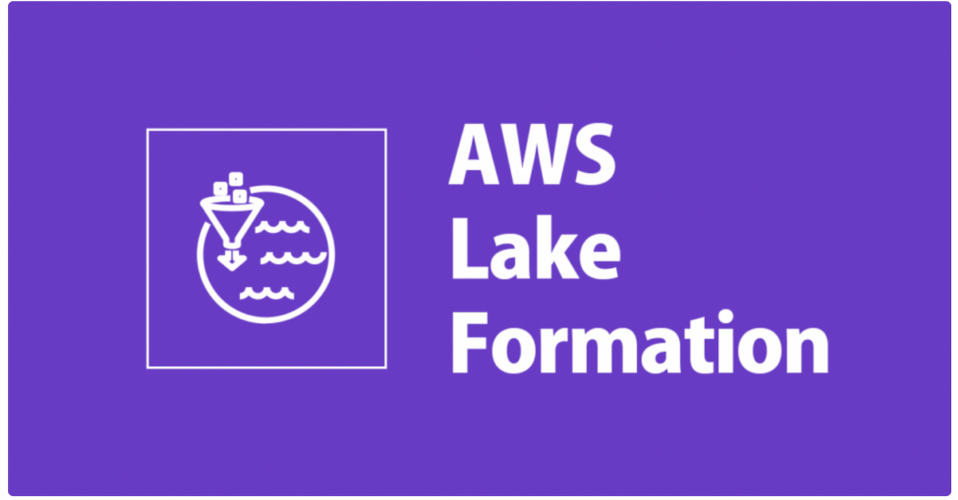

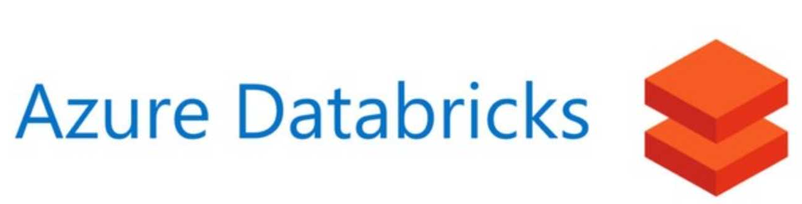
Data Lake Tools

Slide 42
Cloud Computing and Data Management

Slide 43
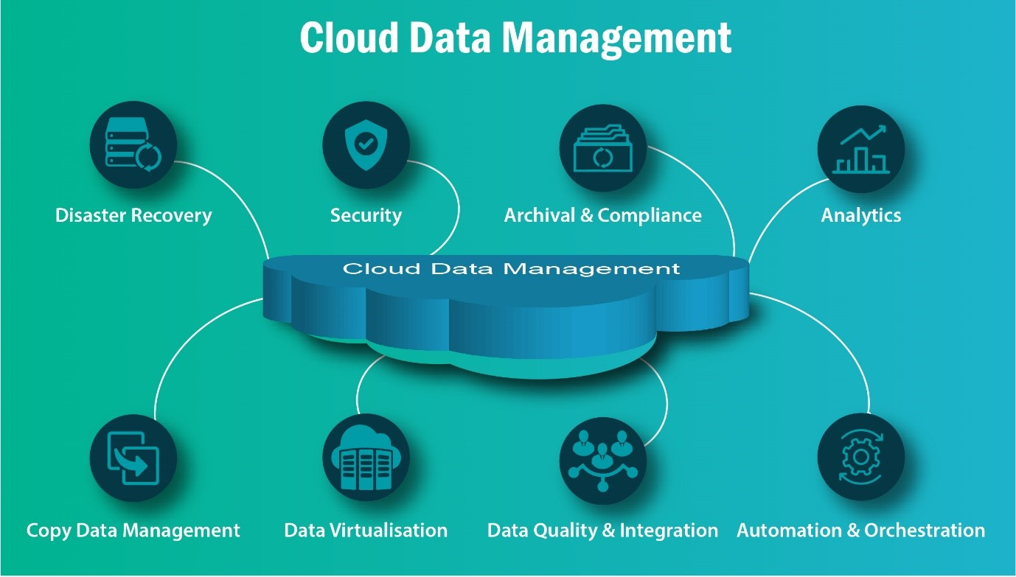
An Overview
Cloud computing: a model for delivering computing services over the internet

Slide 44
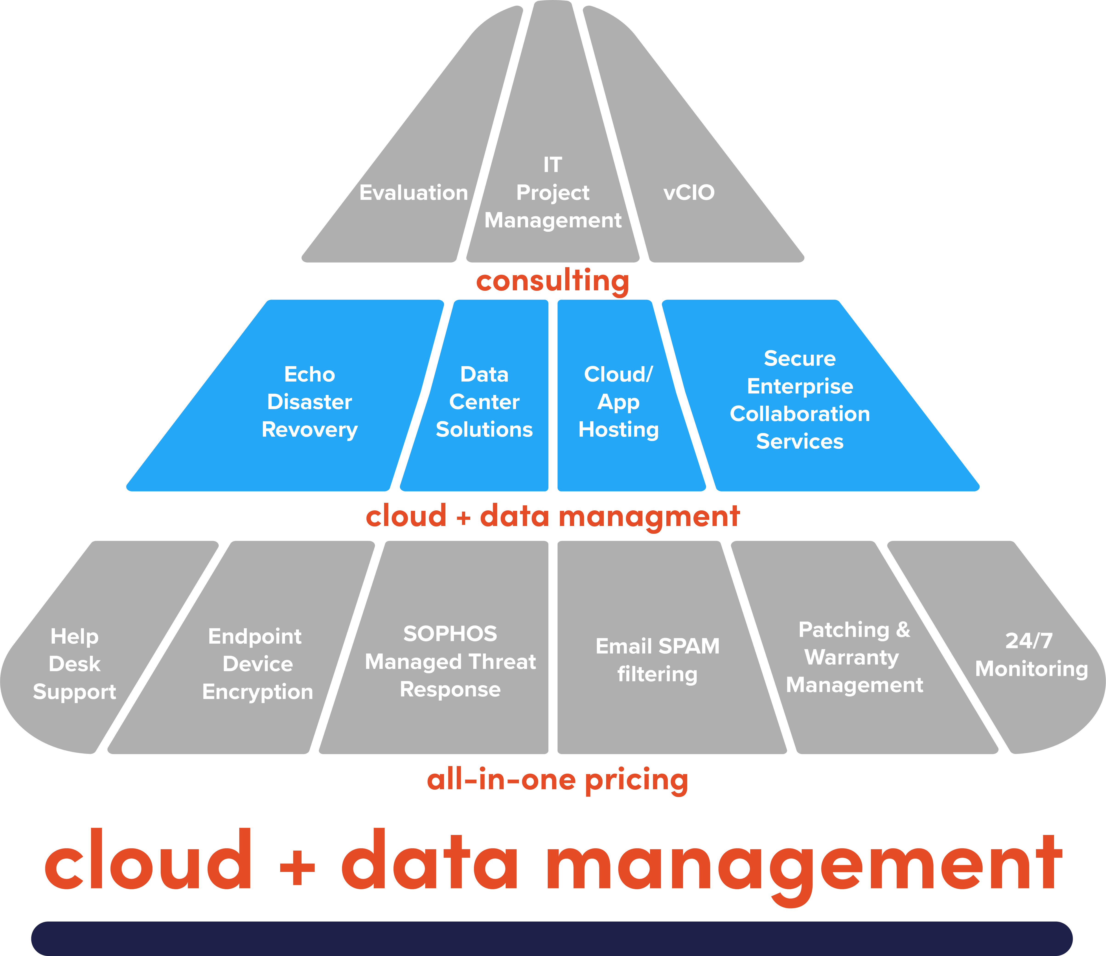
Importance of data management in cloud computing
Data Security
Data Compliance
Data Availability
Data Integrity
Data Governance
Cost Optimization

Slide 45
A Closer Look
Cloud computing is a model for delivering computing services over the internet
Resources such as servers, storage, databases, software, and applications are provided as a service
Users can access and use these resources on-demand and pay only for what they use

Slide 46
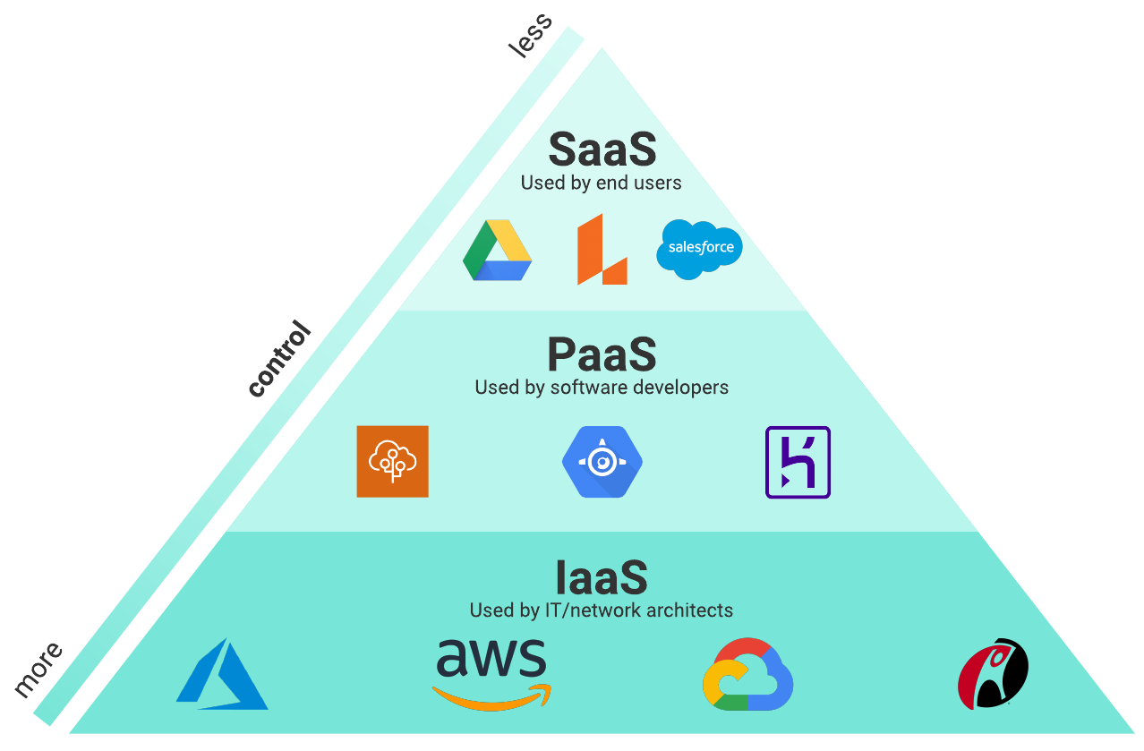
Cloud Computing Service Models

Slide 47
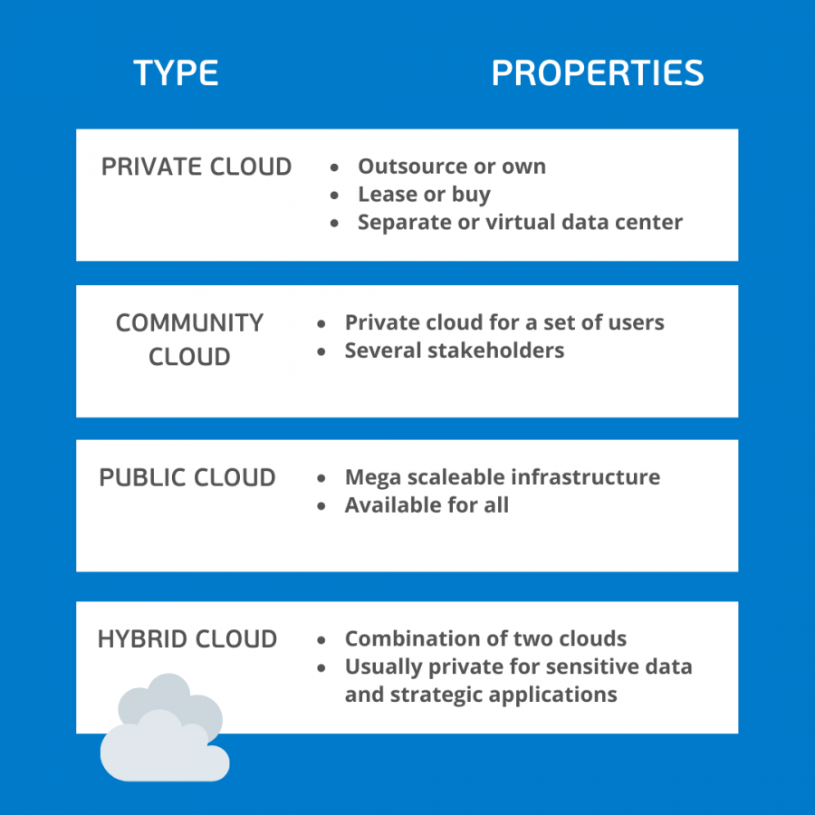
Cloud Computing Deployment Models

Slide 48
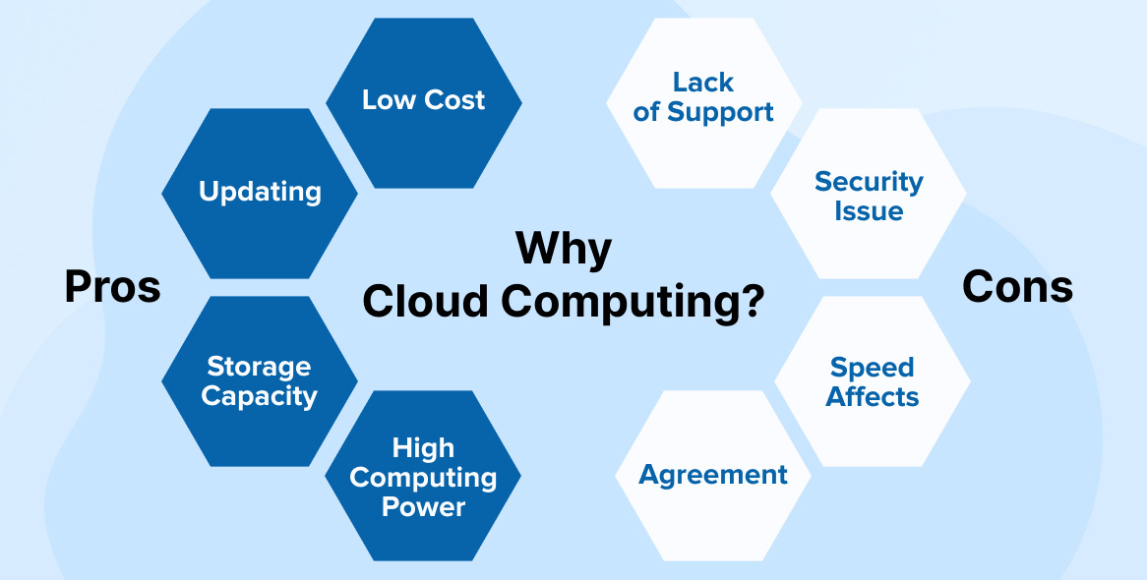
Cloud Computing for Data Management
Pros
Scalability, Flexibility, Cost-Effectiveness
Cons
Security, Compliance, Data Sovereignty

Slide 49
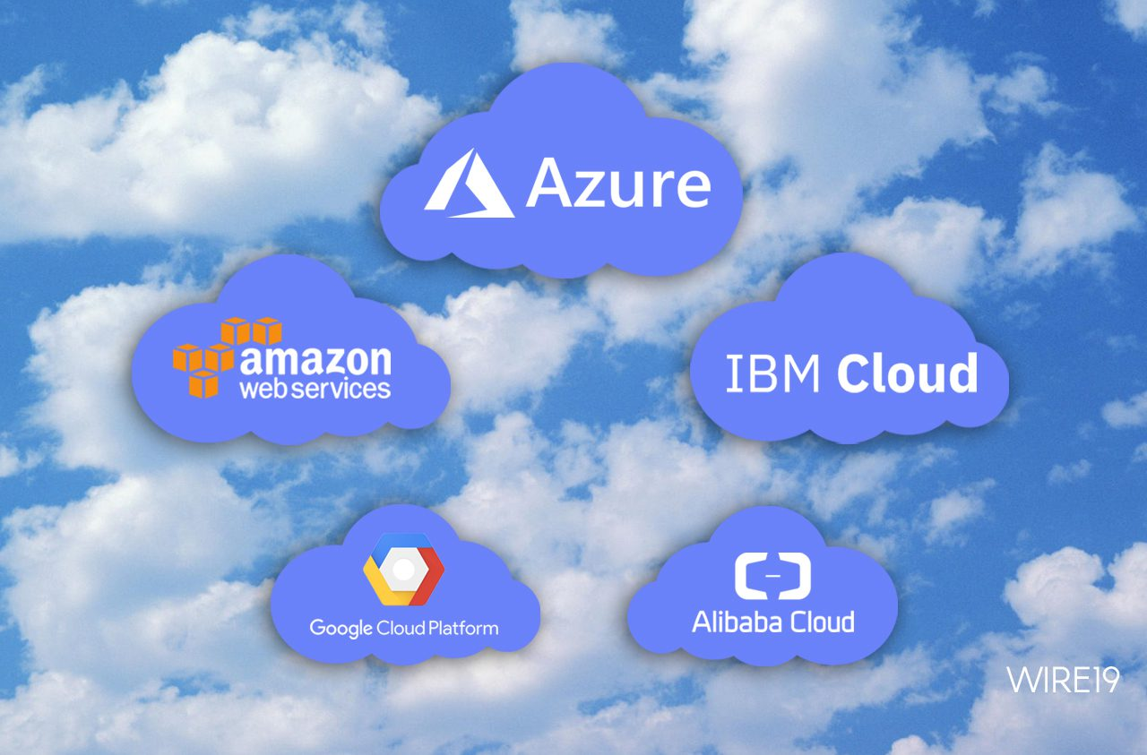
Example of Cloud Computing Platforms

Slide 50
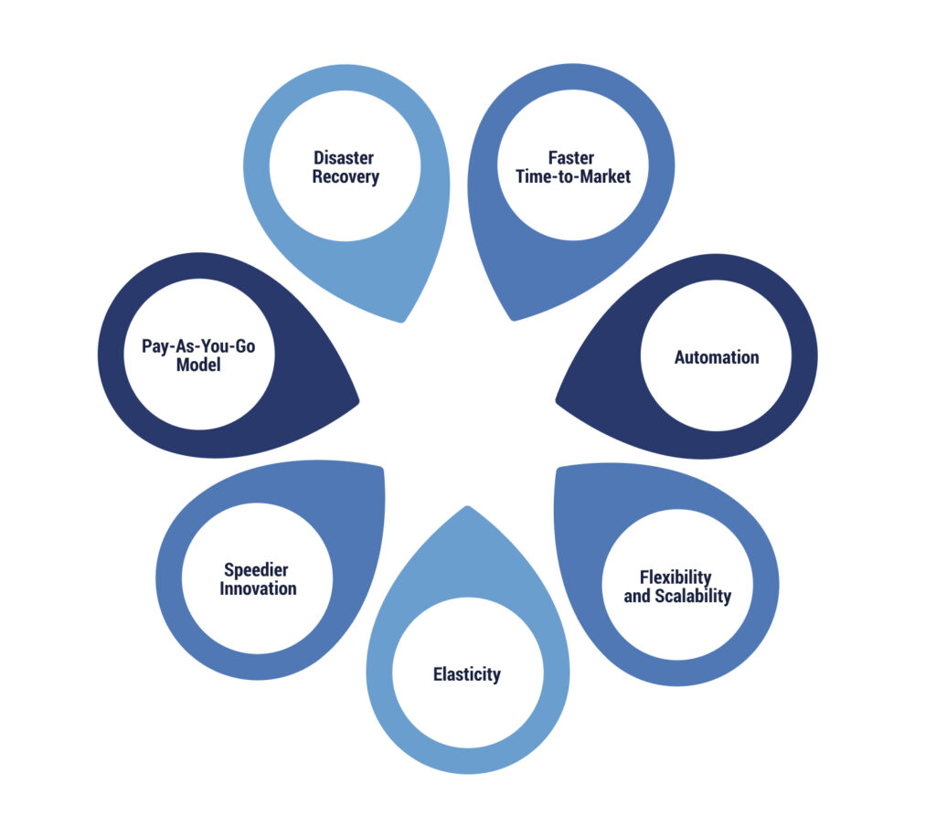
Agility, Innovation, Collaboration

Slide 51
Big Data and NoSQL Databases

Slide 52
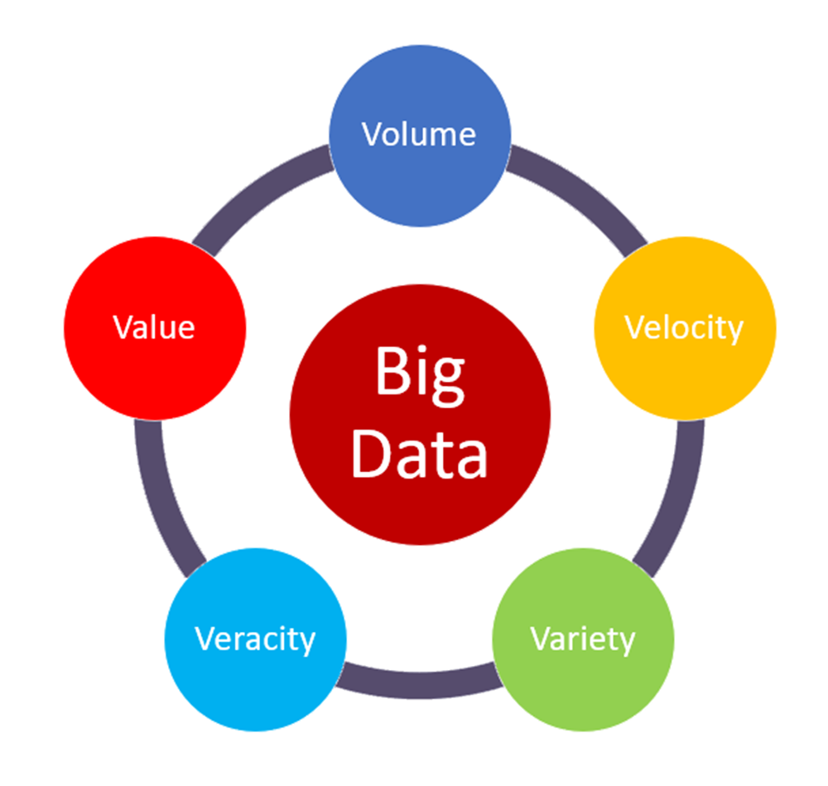
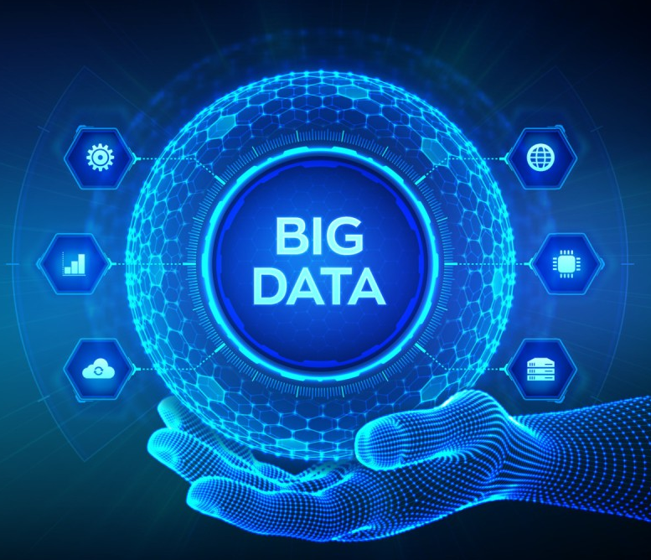
An Overview
Big data
large volumes of data that cannot be processed by traditional data processing tools

Slide 53
A Closer Look
Volume: large amounts of data generated from various sources
Variety: diverse data types, including structured, semi-structured, and unstructured data
Velocity: high speed of data generation and processing
Veracity: data quality and accuracy
Value: data must provide business value

Slide 54
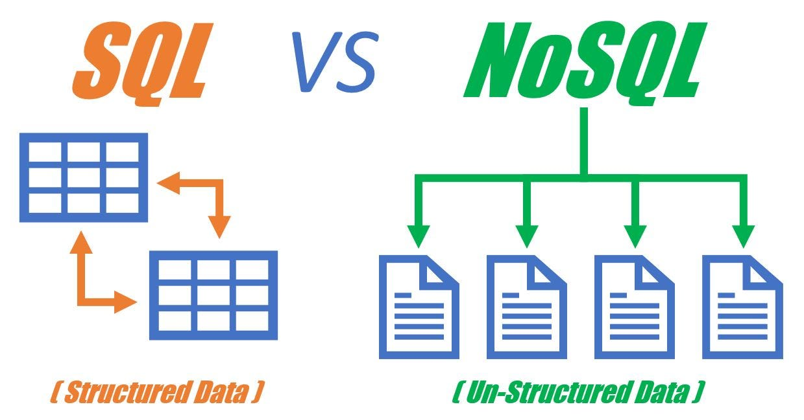
SQL vs NoSQL

Slide 55
A Different Approach to Data Storage
NoSQL databases are designed to handle large amounts of unstructured and semi-structured data
They are horizontally scalable, allowing for easy data distribution and processing
They are schema-less, allowing for flexibility in data storage and retrieval

Slide 56
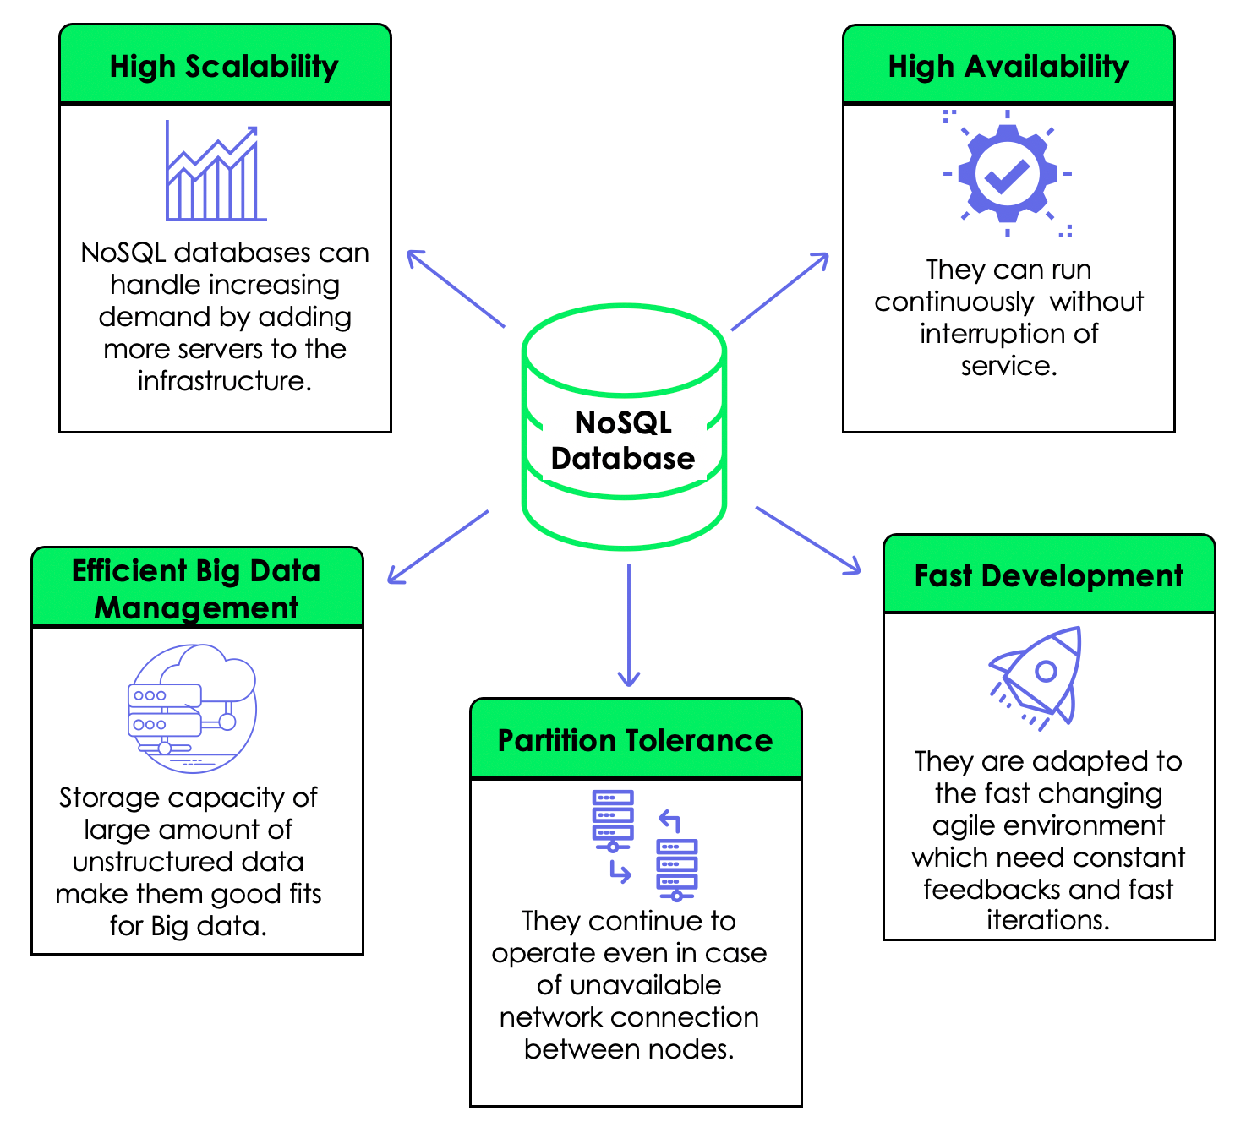

Slide 57
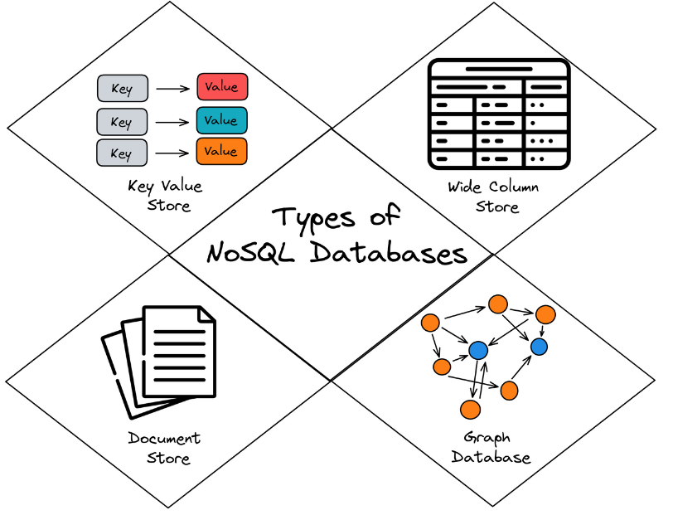
Types of NoSQL Databases

Slide 58
Types of NoSQL Databases
Key-value databases
store data as a collection of key-value pairs
Document databases
store data in the form of documents, such as JSON or XML
Column-family databases
store data in a column-family format, similar to a relational database
Graph databases
store data in the form of nodes and edges, useful for social networks and recommendation systems

Slide 59
Use Cases for Big Data and NoSQL Databases
IoT data processing and analysis
Social media data analysis and sentiment analysis
Fraud detection and prevention
Recommendation systems and personalization
Predictive maintenance and machine learning

Slide 60
NoSQL Databases
E-commerce Applications
Healthcare
Social Media Platforms
Transportation
Real-World Examples:
Netflix: store customer profiles, viewing histories, and content recommendations.
Uber: ride-sharing platform, managing driver and rider profiles, trip histories, and real-time location data.
Airbnb: handle its extensive listings and user interactions data1.

Slide 61




Example of Big Data and NoSQL Database Tools

Slide 62
Comparison of NoSQL databases
Feature | Hadoop | MongoDB | Cassandra | Neo4j | HBase
Data Model | Binary, key-value pairs | Document-oriented | Column-oriented | Graph-based | Column-family based
Data Processing | MapReduce | MongoDB query language | CQL (Cassandra Query Language) | Cypher (Graph query language) | HBase query language
Data Indexing | Secondary indexes | Indexing | Secondary indexes | Indexing | Indexing

